Slide 1

Easylogging ++ is easy to use and compact, does not require third-party libraries or installation. All the code is contained in one single header file.
Website: github.com/muflihun/easyloggingpp
License: MIT
Programming language: C++ 11
Platforms: Windows, Mac OSX, Debian (Ubuntu, Mint), Fedora
Compilers: GCC 4.7+, Visual C++ 11.0+, MinGW, Cygwin

Slide 2
The advantages EL++
Good documentation that describing the main features of the library
Low system requirements
Compact
Easy to use
Cross-platform
Low memory consumption
Large set of accessory macros
Many supported platforms
Support for configuring with a file and a command line
Good efficiency of message filtering

Slide 3
Cons of EL++
Only synchronous logging
Requires C ++ 11
Thread safety is disabled by default
UNICODE is supported, but symbols are not sent to the log file.
Initialization by including in the project a header file of 4500 lines with macros and templates, which you must always have in the project.
A huge performance difference between the debug and release builds.
Conclusion on the EL++
The EL++ is an easy to use logger with standard functionality. Good for small projects.

Slide 4

Boost.Log is a library aims to make logging significantly easier for the application developer. It provides a wide range of out-of-the-box tools along with public interfaces for extending the library. The main goals of the library are: Simplicity, Extensibility, Performance
Website: boost.org/doc/libs/1_64_0/libs/log/doc/html/index.html
License: Boost Software License v1.0
Programming language: C++
Platforms: Windows, Mac OSX, *nix
Compilers: GCC 4.5+, MSVC 8.0+, Clang 3.2, Borland C++ 5.5.1

Slide 5
The advantages Boost.Log
Supports synchronous and asynchronous logging
The most complete and convenient documentation that covers all the basic needs
Cross-platform
Supports Unicode
Thread safety
Support for configuring with a file
Many supported sinks

Slide 6
Cons of Boost.Log
One of the lowest performance among the reviewed libraries
A huge performance difference between the debug and release builds.
Working with UNICODE is very unstable (Without using Boost.Locale)
Sometimes you need to catch exceptions by yourself
Complex attributes of messages. Creating a custom attribute is not an easy task.
Very slows down the compilation
Conclusion on the Boost.Log
The library has a wide range of capabilities that cover most of the user's requests. But it is a bad option for small projects because of the slow work and complexity. And also due of poor stability, it is not suitable for large projects.

Slide 7

Log4cpp – The goal of the project is to create a log4j-like logging structure that tries to avoid huge dependencies in the main functionality (like in Boost) and use standard C ++ objects instead.
Website : https://sourceforge.net/p/log4cplus/
License : Apache License V2.0
Programming language : C++
Platforms: Windows,*nix, Solaris
Compilers: GCC 4.5+, MSVC 8.0+, Clang 3.2

Slide 8
The advantages Log4cpp
Many supported sinks
Generated Documentation
Support for configuring with a file
Good efficiency of message filtering
Cross-platform
Thread safety
Low memory consumption

Slide 9
Cons of Log4cpp
Only synchronous logging
There is no UNICODE support
A huge performance difference between the debug and release builds.
Low performance
Limited string size (1024 symbols)
Conclusion on the Log4cpp
A library that is also like Easyloggingpp is great for small projects, but due of poor performance there are some doubts about the applicability of large ones.

Slide 10
P7 Library
P7 – An open source library for high-speed logging and telemetry from an application with minimal CPU and memory usage.
Website : baical.net/p7.html
License : GNU LESSER GENERAL PUBLIC LICENSE v3.0
Programming language : C/C++, C#, Python
Platforms: Windows,*nix, Solaris
Compilers: GCC 4.5+, MSVC 8.0+, Clang 3.2

Slide 11
The advantages P7
High performance
UNICODE support
Cross-platform
Thread safety
Supports synchronous and asynchronous logging
Many supported sinks
Built-in ability to transfer and store logs on its own server (Baical)
Control from Baikal server
It is possible to send telemetry
Trace and telemetry files can be presented in a compact binary format, which makes the source file 5-7 times smaller than files obtained with other libraries
There are wrappers for C, C #, and Python
Works even if different parts of the application are written in different languages

Slide 12
Cons of P7
As a percentage, it has the biggest drawdown in performance when used from multiple threads (but still much faster than all the others)
Baikal has a version only for Windows
Conclusion on the P7
P7 – The library is great for large and small projects. It supports many languages, has better performance, telemetry, as well as its own server for receiving and storing logs. All this makes P7 the best among the others logging libraries.

Slide 13
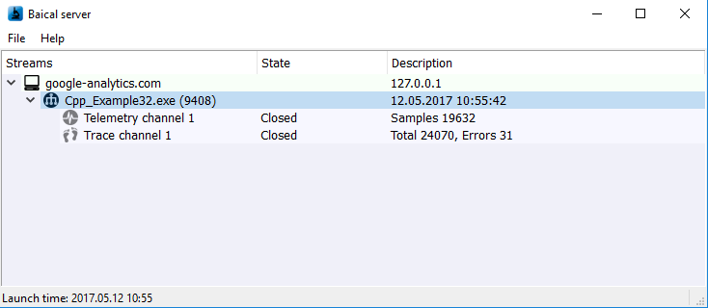
Example output logs in Baical

Slide 14
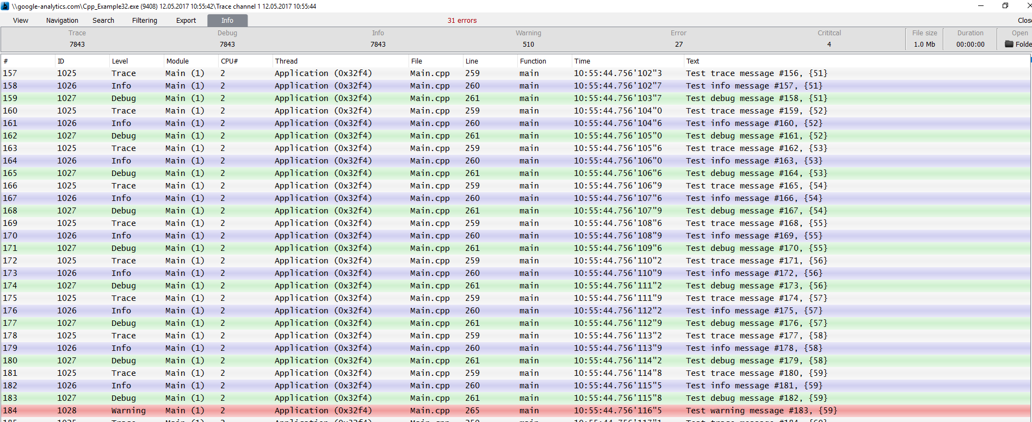
Logs

Slide 15
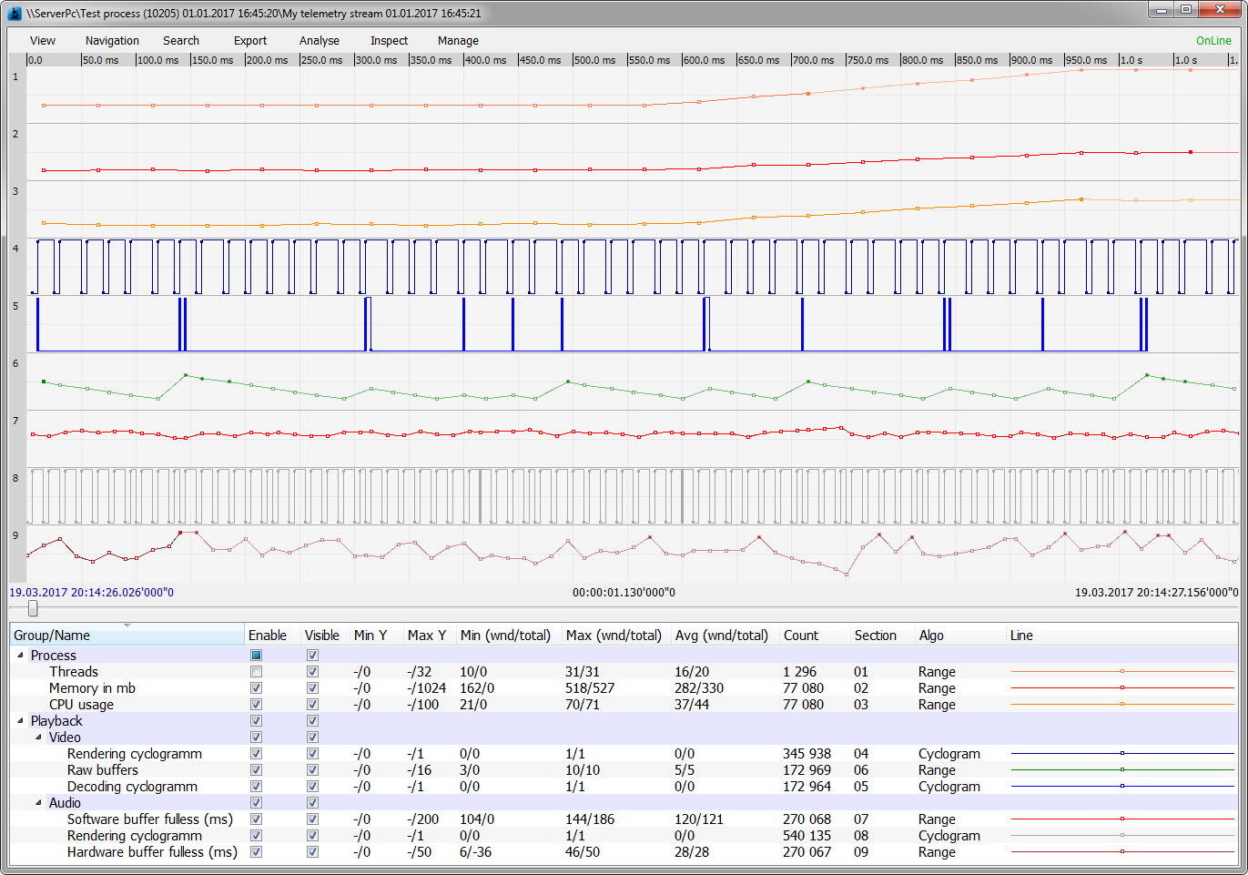
Telemetry

Slide 16
Performance test
PC Configuration
Windows 10х64 Enterprise.
RAM 8Gb.
Intel Core i3-2100.
HDD - Seagate ST1000VX000.
Microsoft Visual Studio Professional 2017 RC

Slide 17
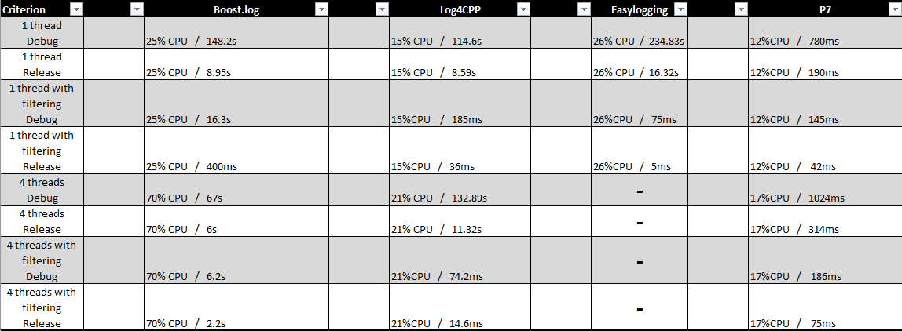

Slide 18
